Slide 1


Slide 2
Boggle game

Slide 3
Q | S | Y | D | Z
W | J | U | R | V
G | C | H | F | I
M | O | L | N | V
T | P | B | A | E

Slide 4
survive - grow - elephant
jump – hear - climb
move – animal – fly - intelligent

Slide 5
UNIT 3: WILD LIFE
Lesson 5
Language Focus
• can for ability
• might
• Questions with How ... ?

Slide 6
CAN for ability
EXERCISE 1
1. can 2. can’t
3. Can 4. can
5. can’t 6. Can
7. can 8. can’t
Rules:
can
2. can’t
3. can and can’t
4. the same

Slide 7
CAN for ability
FORM
Affirmative form
Negative form
Question
S + can + V₀ + O
S + can’t + V₀ + O
(cannot)
Can + S + V₀ + O ?

Slide 8
CAN for ability
EXERCISE 2
1. can 2. Can
3. can 4. can’t
5. can

Slide 9
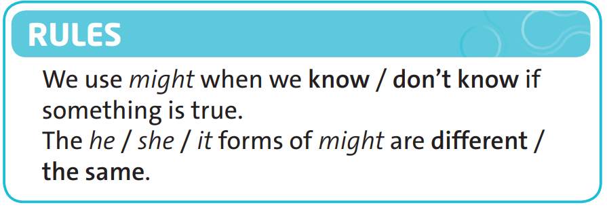
MIGHT for possibility
EXERCISE 3

Slide 10
QUESTIONS WITH HOW ... ?
EXERCISE 4
1. How fast 2. How many
3. How tall 4. How long
5. How far

Slide 11
QUESTIONS WITH HOW ... ?
EXERCISE 5
1. Around 44 kilometres an hour
2. 195 (recognised by the United Nations)
3. Between 5 and 6 metres
4. Around 4 metres
5. 20,014 kilometres

Slide 12

Speaking time

Slide 13
HOMEWORK
- Do exercise in Workbook page 27
- Prepare for the next lesson:
SPEAKING • Asking for permission

